Slide 1
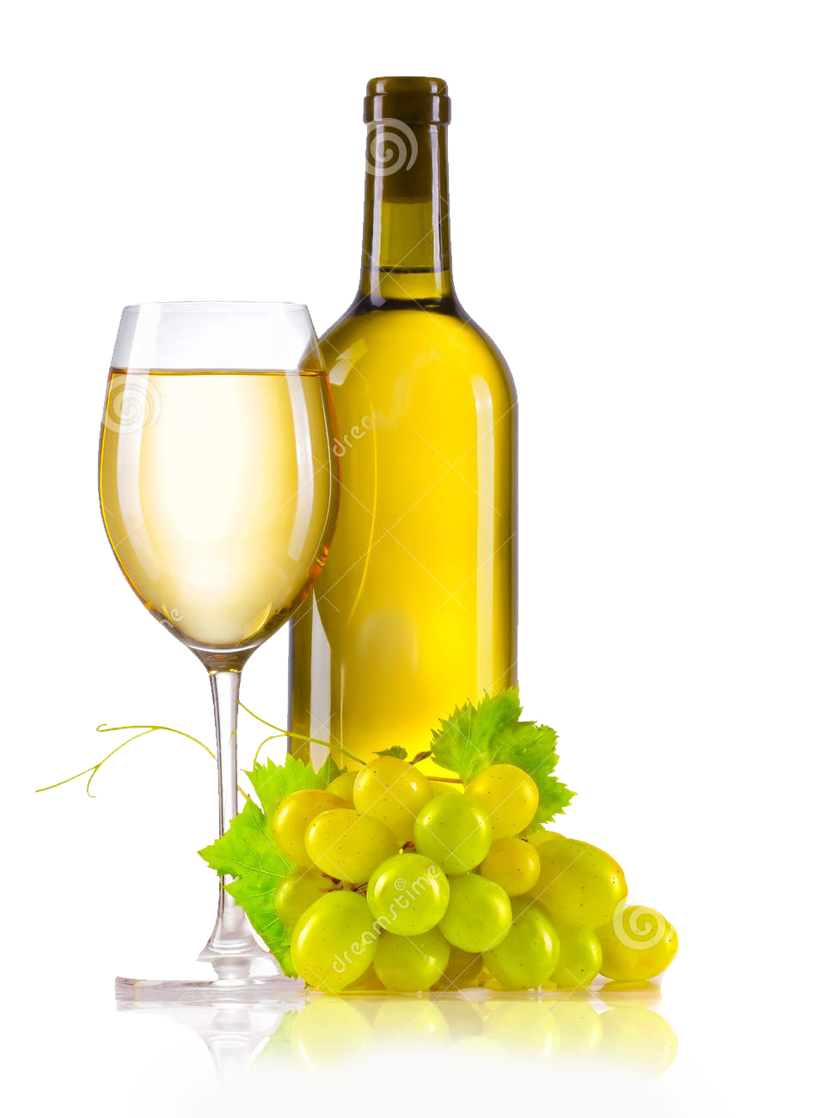
The good, the bad, the average: White wine edition
Julie Nguyen
DS5K Capstone

Slide 2
Introduction
People have been consuming more wine during the lockdown compared to the previous year. This increased popularity of wine consumption might mean there could be a desire for wine consumers to want to develop their senses determining wine quality. For these novices, determining whether a wine is good is about developing their palettes.
This project aims to determine which white wines are bad, average, or good.

Slide 3
Motivation
For a wine novice, determining what the best wine is difficult because there can be both complex flavors and seemingly indiscriminate sensory factors that determine what a high-quality wine. Since wines have specific biochemical factors, using these factors could help determine where the wine could fall based on a sensory determined quality rating.
Biochemical factors can affect the flavor of a wine which could make an impact on how sommeliers and other wine experts determine what is a high-quality wine.

Slide 4
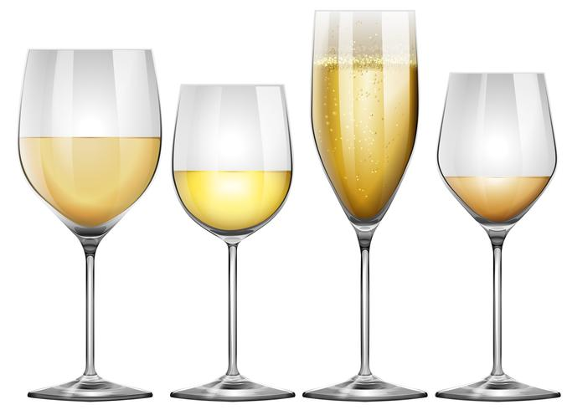
Research Question
Problem: Predicting whether a wine is bad, average, or good based on biochemical factors.
Hypothesis: If there is white wine is more acidic, it is a good wine.

Slide 5
Data Set
This 2009 dataset is from the UCI Machine Learning Repository here: https://archive.ics.uci.edu/ml/datasets/wine+quality.
There are 12 features and 4898 wines Portuguese "Vinho Verde” white wines are sampled.
There are 11 biochemical variables determined by physicochemical tests and 1 sensory variable which determined the quality.
Each sample was evaluated by a minimum of three experts which graded the wine in a scale that ranges from 0 (very bad) to 10 (excellent). The final sensory score is given by the median of these evaluations.

Slide 6
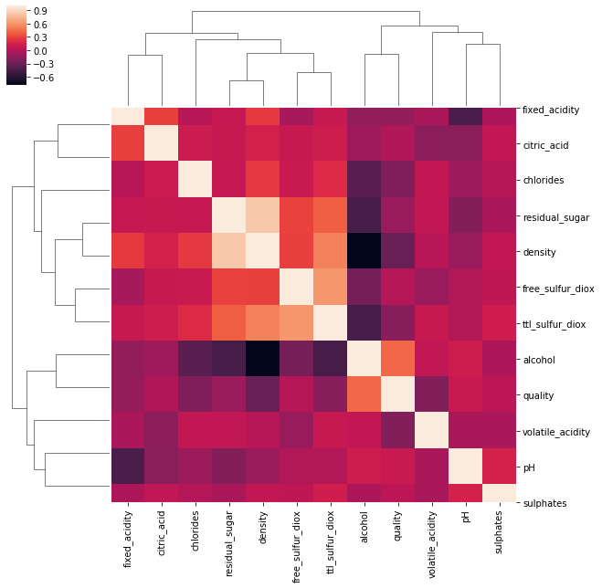
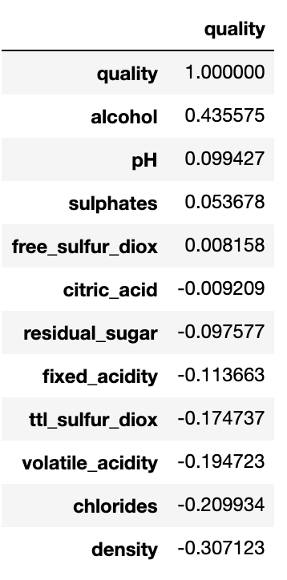
Exploratory Data Analysis
Features:
fixed acidity volatile acidity citric acid residual sugar chlorides free sulfur dioxide total sulfur dioxide density pH sulphates alcohol quality
Notes:
Shape:
4898, 12

Slide 7
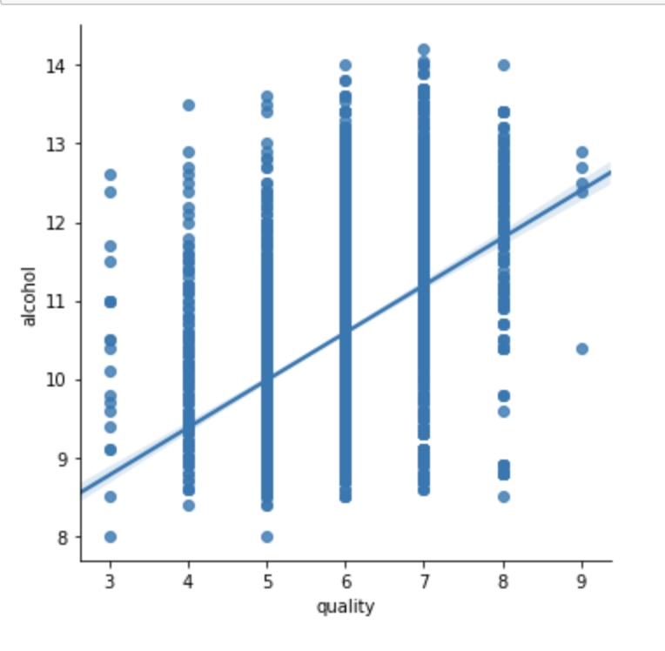
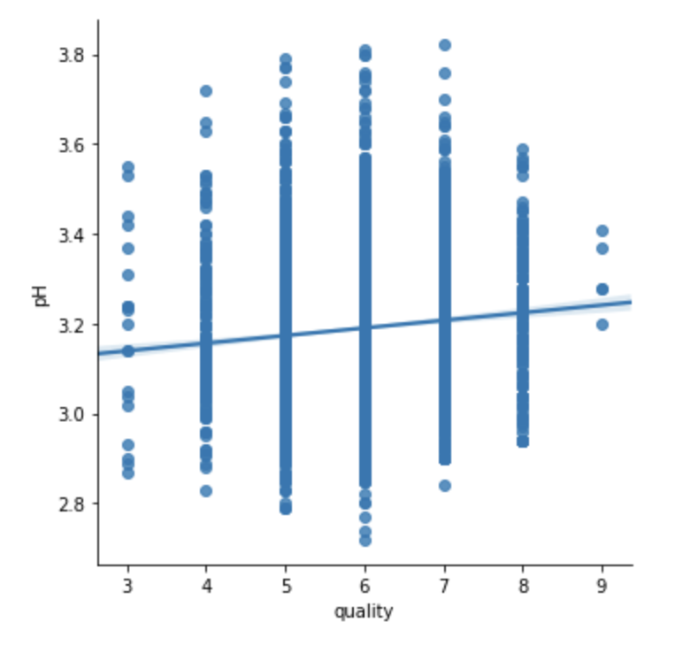
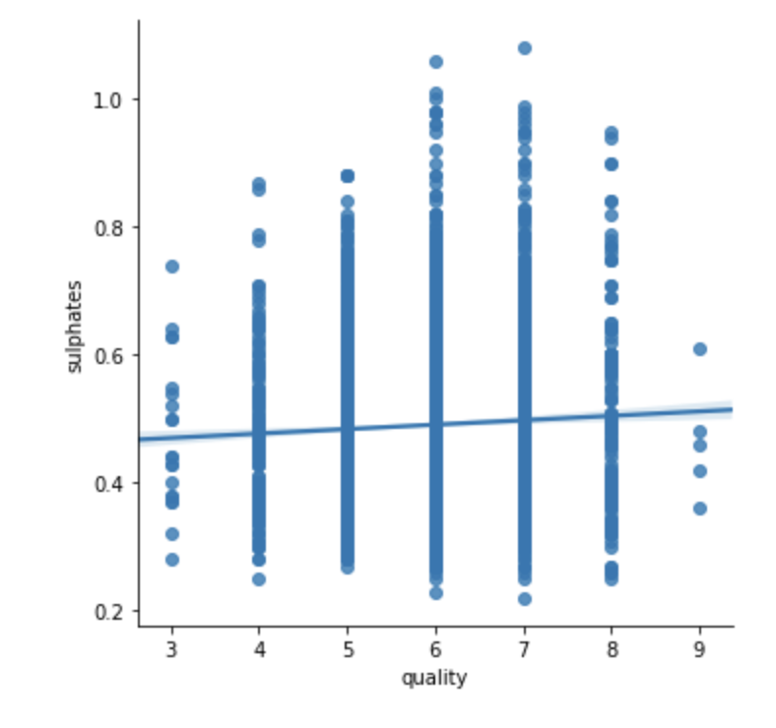
Exploratory Data Analysis
Features:
fixed acidity volatile acidity citric acid residual sugar chlorides free sulfur dioxide total sulfur dioxide density pH sulphates alcohol quality
Quality | # of wines
6 | 2198
5 | 1457
7 | 880
8 | 175
4 | 163
3 | 20
9 | 5

Slide 8
Logistic Regression
Baseline
This model used all 11 biochemical features for X and the quality variable for y
Used Train/Test with StandardScaler
Accuracy: 0.5382147024504084
Feature Selection
Used ExtraTreesClassifier for feature selection - pH, sulphates, alcohol, volatile_acidity
Used Train/Test with StandardScaler
Accuracy: 0.5271295215869312

Slide 9
Logistic Regression
Rating Response Variable
This model used a created Rating variable that bucketed quality scores into three groups (1-Bad, 2-Average, 3-Good) with the 11 features.
Used Train/Test with StandardScaler
Accuracy: 0.9617852975495916
Feature Selection with Rating Variable
Used ExtraTreesClassifier for feature selection - pH, sulphates, alcohol, volatile_acidity
Used Train/Test with StandardScaler
Accuracy: 0.9614935822637106

Slide 10
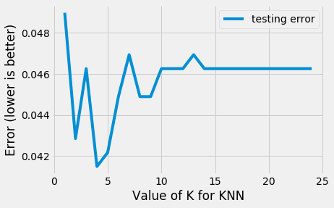
K Nearest Neighbors
Rating Response Variable (y) + 11 features (X)
Used Train/Text with StandardScaler
Found the best K value of 4
Accuracy: 0.9585034013605442

Slide 11
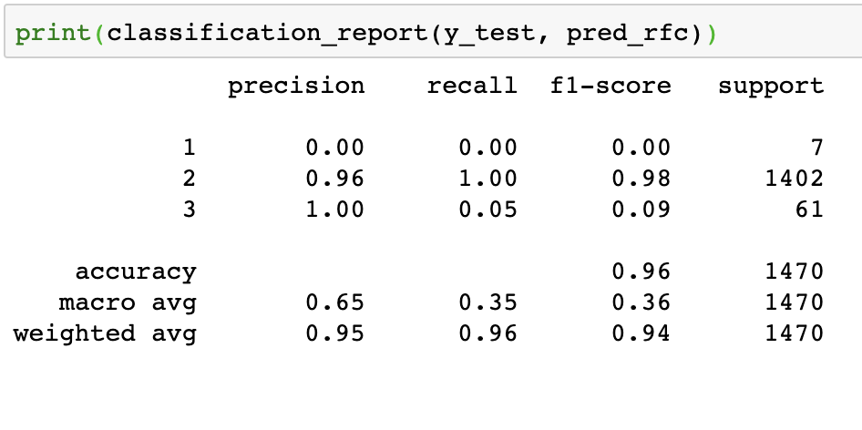
Random Forest
Rating Response Variable (y) + 11 features (X)
Used Train/Text with StandardScaler
N_estimator = 200
Accuracy: 0.96

Slide 12
Conclusions & Limitations
Overall, after creating a categorical ratings variables, all the models all seem to be accurate in determining the which wines were Bad, Average, or Good.
It seems that white wines with less alcohol would skew more towards the bad and average side.
It also seems that most good white wines had a pH of no more than 3.5 so perhaps these wines were more tart.
However, since this dataset was sampled from one Portuguese winery and this dataset has no data about things like grape types, wine brand, wine selling price, etc. All which could influence the quality variable in some aspect.

Slide 13
Next Steps
Do the same type of models on the red wine to see which variables might be different in red wine.
Do more tuning on Random Forest just because.
Combine the white and red and see if there is a way to determine which combination of biochemical factors could determine if a wine is red or white.
See if other wineries have datasets like this.

